Slide 1


COFFEE SHOP
Facility HTML Structure
Facility

Slide 2
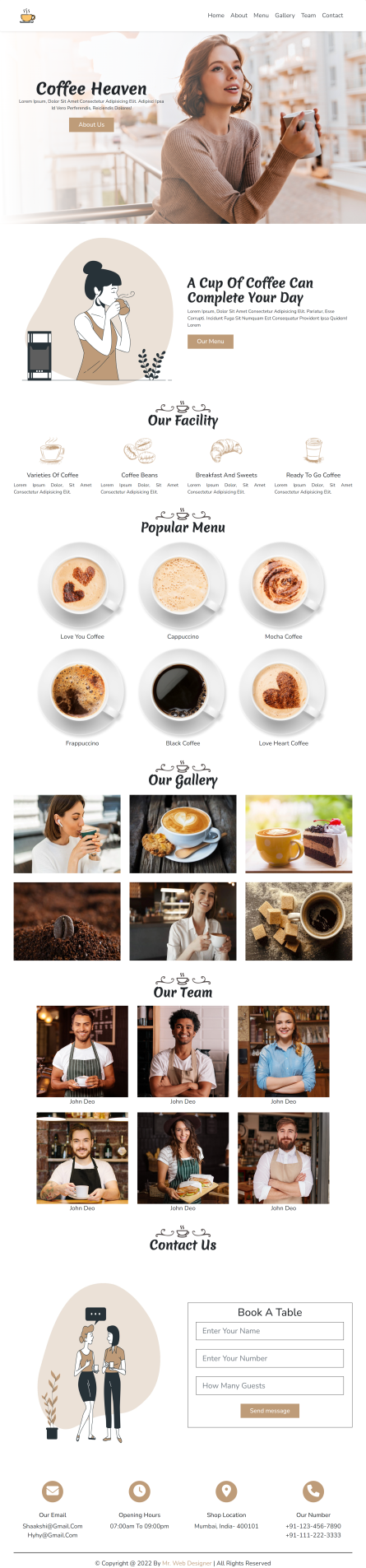
HTML Structure
Components
Total number of Components
Parent Containers Of Any website
Number of Components in Coffee Shop Website
1. header
1.navBar
2. main
2.heroSection
3. footer
3.about
4.facility
5.menu
6.gallery
7.team
8.contact
9.contactIcons

Slide 3
Html Structure
Components
Total number of Components
Containers
1. header
1.navBar
2.heroSection
2. main
3.about
4.facility
5.menu
6.gallery
7.team
3. footer
8.contact
9.contactIcons

Slide 4
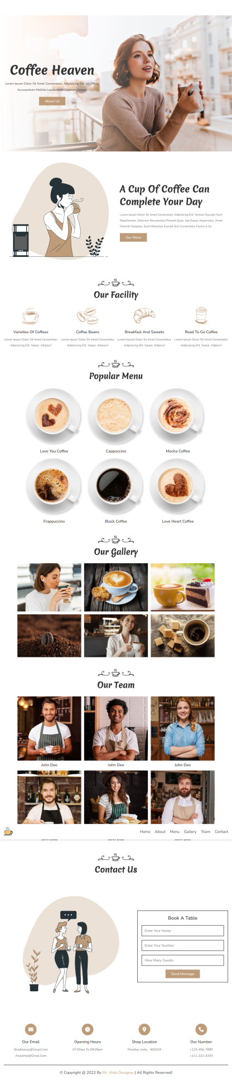
HTML Structure
Components
How to Group Components into the Parent Containers
1.navBar
1. header
2.heroSection
3.about
4.facility
2. main
5.menu
6.gallery
7.team
3. footer
8.contact
9.contactIcons

Slide 5
Facility

Slide 6
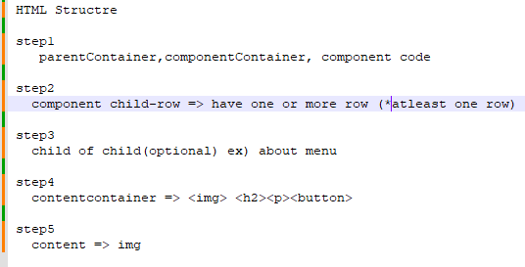

Slide 7
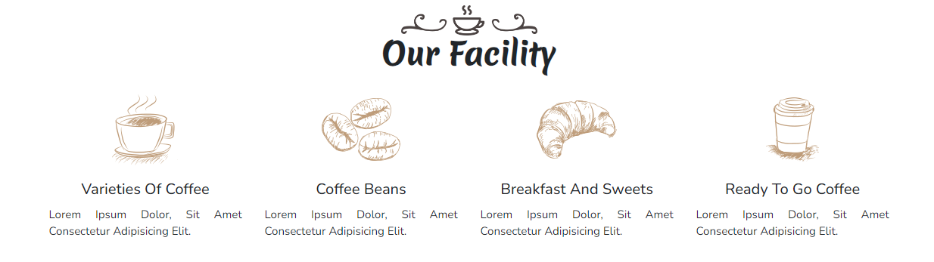
HTML Structure
Containers
4.Facility

Slide 8
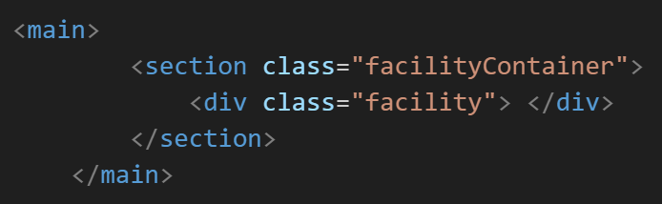
Html Structure
Containers
4.Facility
STEP-1
parentContainer,componentContainer,componet
main
facilityContainer
facility

Slide 9
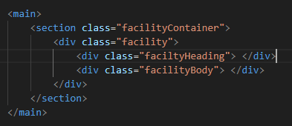
HTML Design
Containers
4.Facility
main
STEP-2
componentChild
facilityContainer
facility
facilityHeading
facilityBody

Slide 10
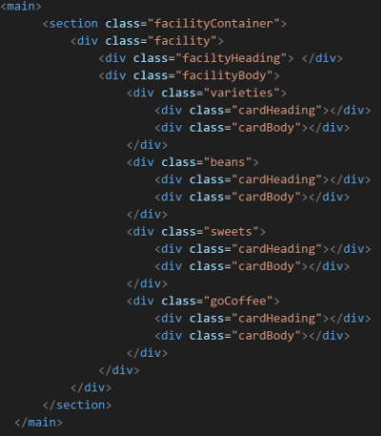
Layout Design
Containers
4.Facility
main
STEP-3
childOfChild
facilityContainer
facility
facilityHeading
facilityBody
varieties
beans
sweets
goCoffee
cardheading
cardBody

Slide 11
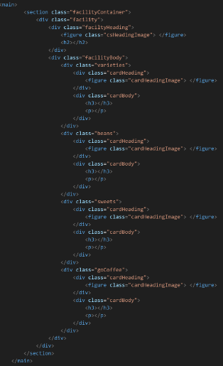
Layout Design
Containers
4.Facility
main
STEP-4
Content
Container
facilityContainer
facility
facilityHeading
facilityBody
varieties
beans
sweets
goCoffee
cardheading
cardBody
csHeadingImage
cardHeadingImage
<img><h2><h3><p>

Slide 12
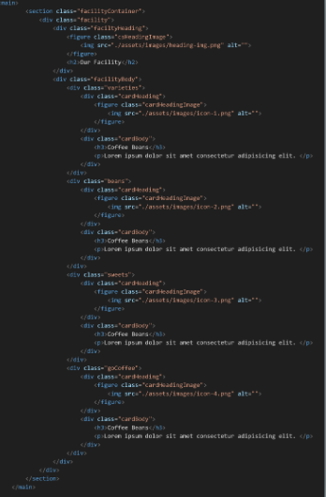
Layout Design
Containers
4.Facility
main
STEP-5
Content
facilityContainer
facility
facilityHeading
facilityBody
varieties
beans
sweets
goCoffee
cardheading
cardBody
csHeadingImage
cardHeadingImage
img,Our Facility,h3,p

